Slide 1
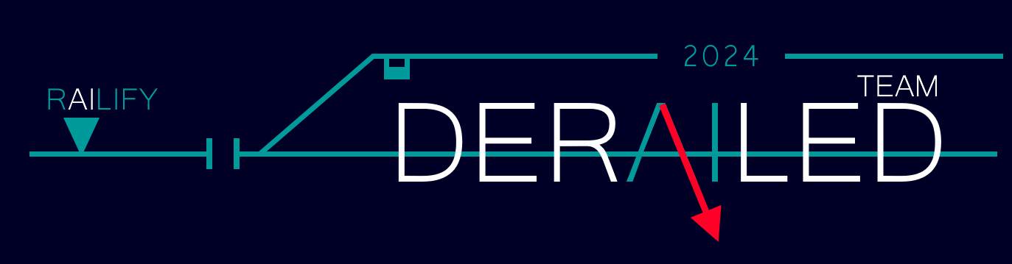
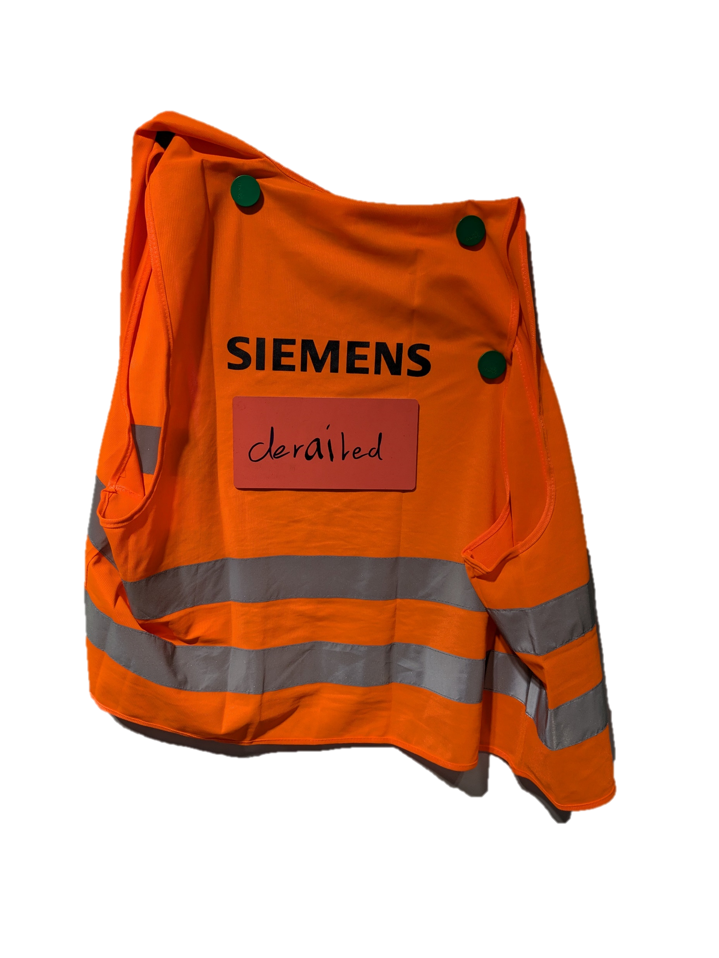
Adrian Altermatt, Johannes Casaburi, Zora Fuchs, Noah Grun, Sarah Rebecca Meyer, Patrick Schwartz, Amar Tabakovic

Slide 2
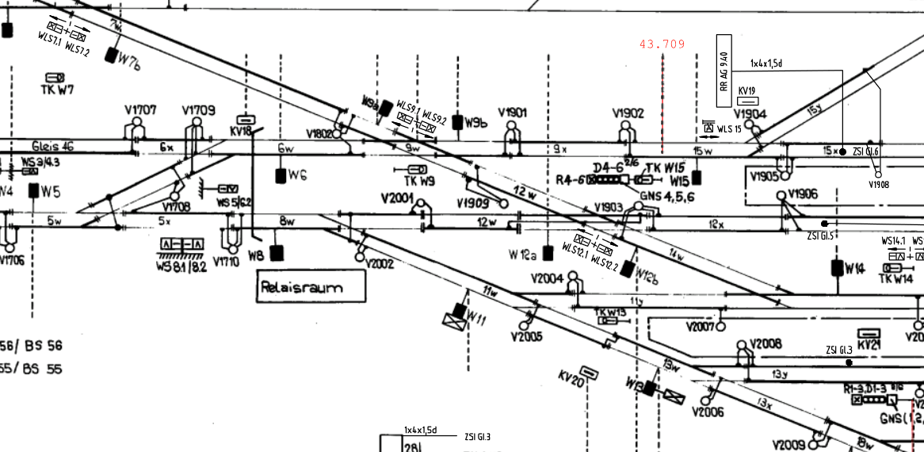
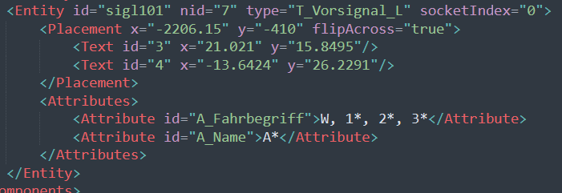
From this ...
To this ...
Handdrawn
Old
Structured
Digital

Slide 3
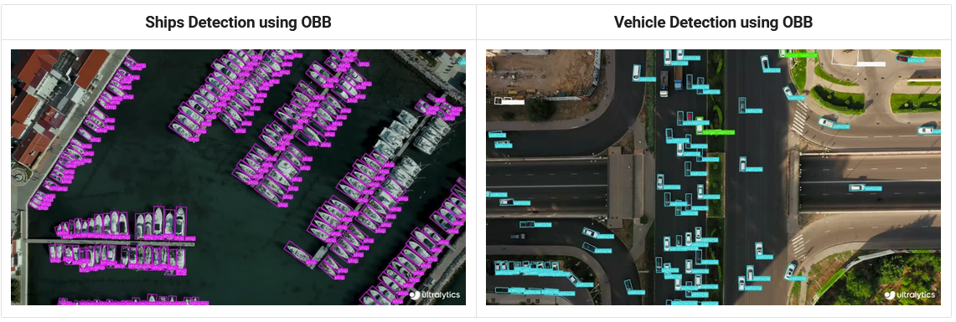
First step: Object detection
OpenCV too unreliable
The solution: YOLO

Slide 4

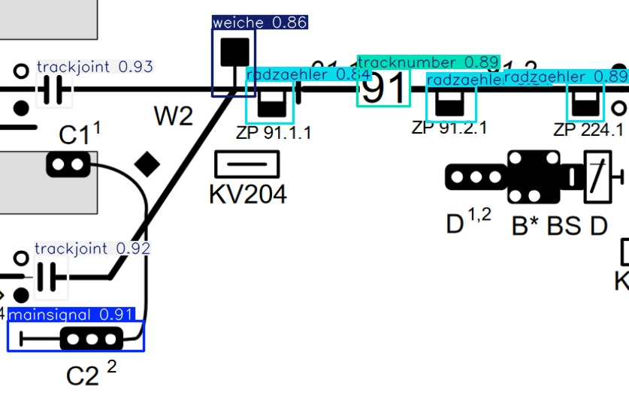
Buuuuut...
We need training data to detect our objects
Manual labelling
We only labelled 5 objects
And tadaaaaa...

Slide 5
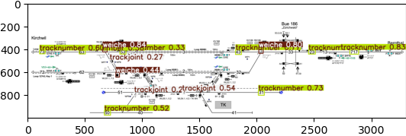
Onto the next problem
YOLO can only handle 640x640 pixels at once.
3 trackjoints, 8 tracknumbers, 3 weiches

Slide 6
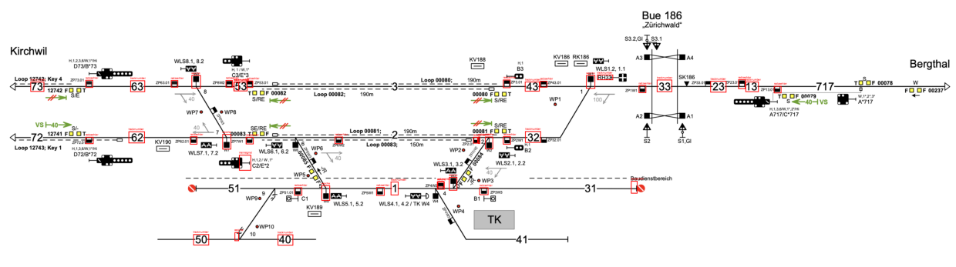
Split the image
Sliding window approach
Symbol: radzaehler, Count: 21 Symbol: tracknumber, Count: 14 Symbol: weiche, Count: 8 Symbol: mainsignal, Count: 1

Slide 7
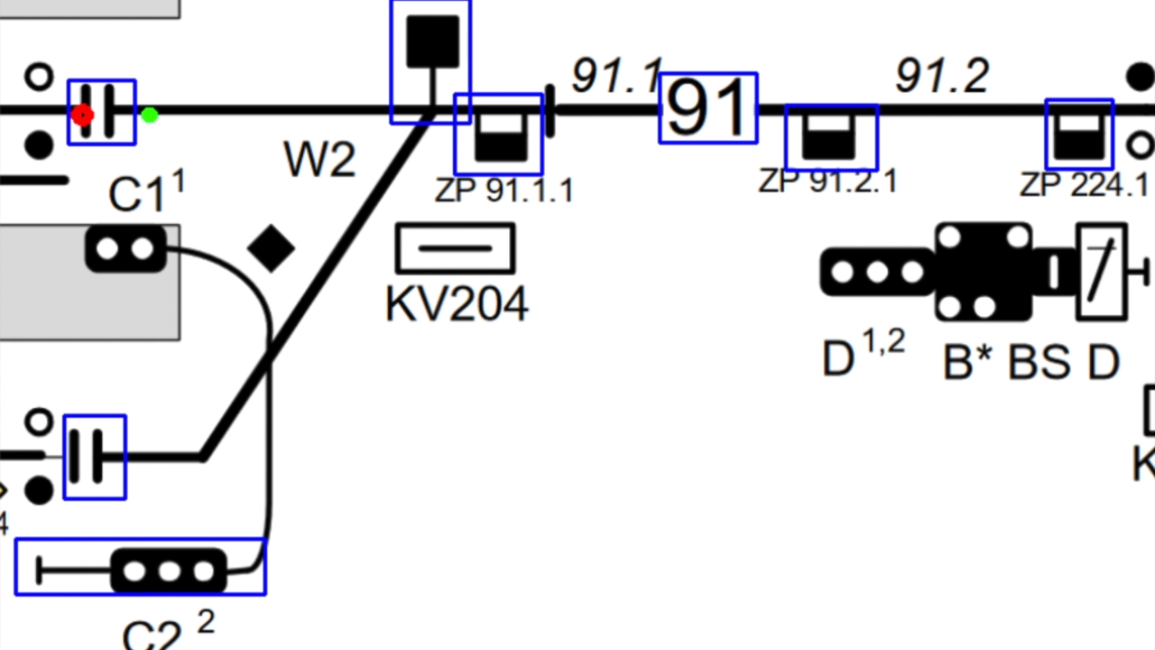
Structuring the data
Follow the lines
Detect objects
To JSON

Slide 8
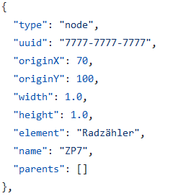
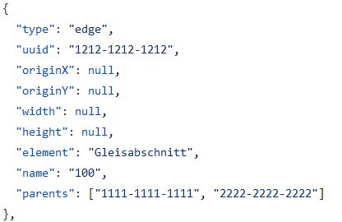
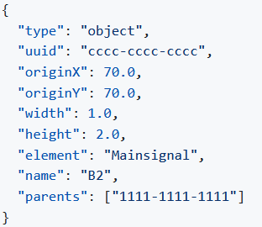
JSON

Slide 9
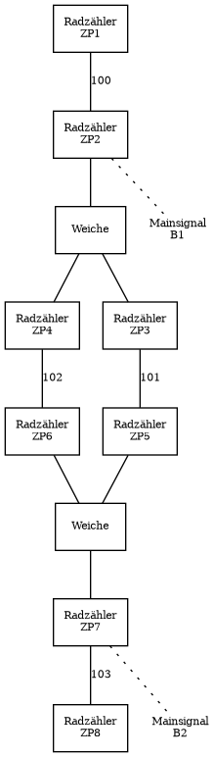
Visualize

Slide 10
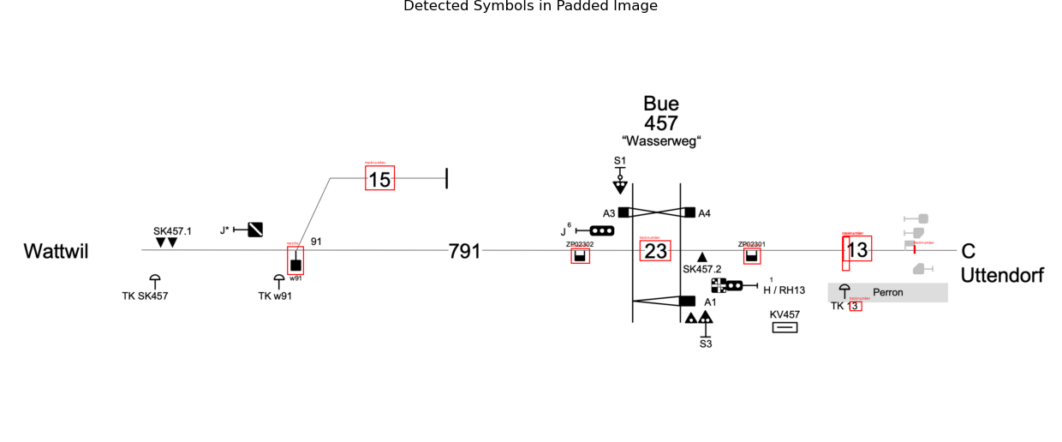
11 AM challenge

Slide 11
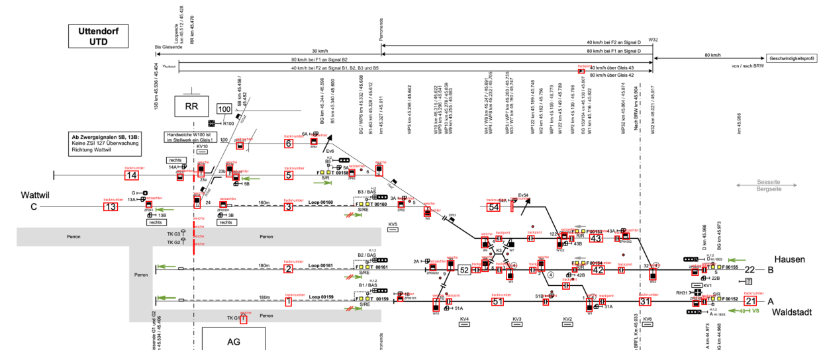

Slide 12
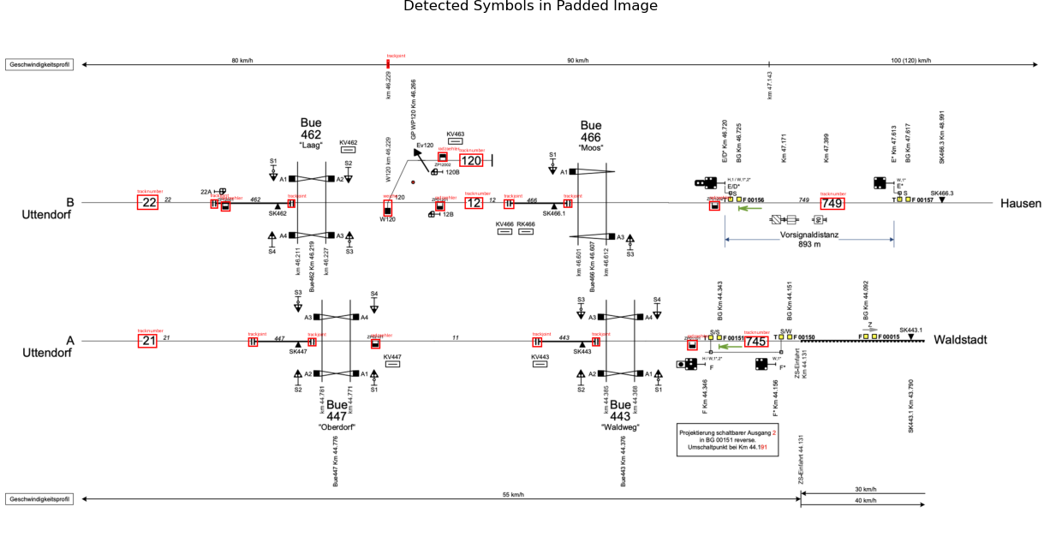

Slide 13
We prove that...
... we can detect object
... we can structure data
... we can visualize it

